Slide 1
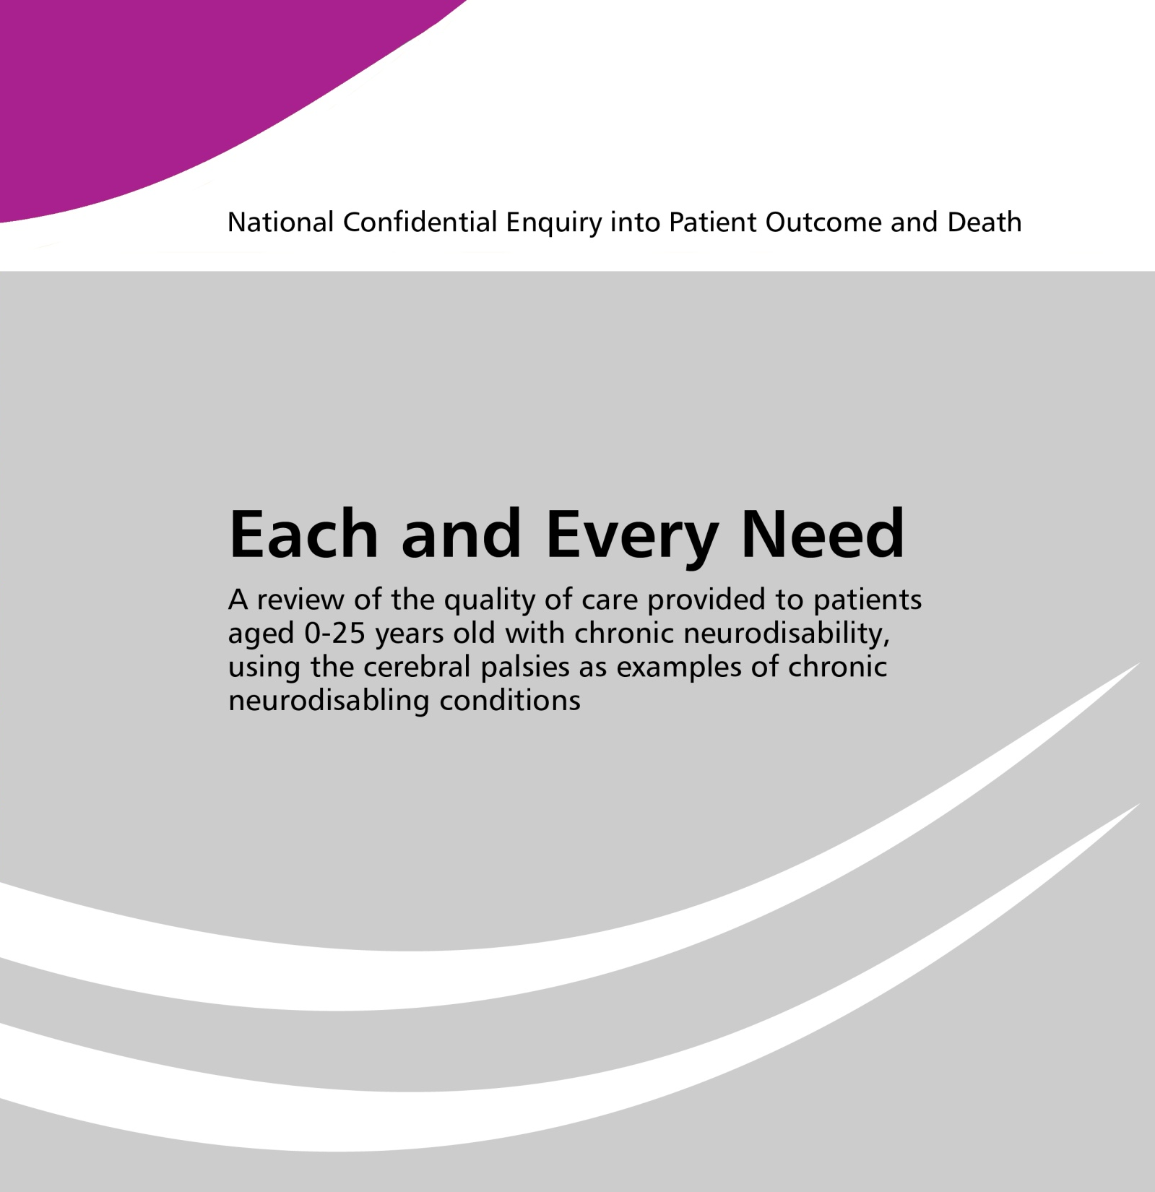

#NeuroDis

Slide 2
Heather Freeth
NCEPOD METHOD

Slide 3
Background
Overview of child deaths in the four UK countries – RCPCH 2013
  71% of children who died had a chronic condition, most frequently neurological
Cerebral palsies – an example of chronic neurodisability
  Encompass a broad spectrum of severity
  Healthcare is delivered in a range of settings
  Service provision becomes fragmented following transition

Slide 4
Aims
Review the quality of care provided to children and young people with a chronic neurodisability, using the cerebral palsies as the exemplar condition
Examine the interface between care settings
Assess the transition of care from paediatric to adult services

Slide 5
Objectives
Organisational
  Access to healthcare services
  Delivery of healthcare services
Patient and parent carer
  To understand the views of service users

Slide 6
Objectives
Clinical
  To gain an in-depth view of the care received by patients, to highlight where improvements could be made as well as good care
    Clinical services
    Symptom management
    Support services
    Communication
    Training
    Safeguarding
    Transition
    Decision making

Slide 7
Method – clinical review
Participating sites
Study population
  0-25 years
  ICD10 code for cerebral palsy
  Admitted between Monday 7th Sept – Sunday 18th October 2015
Case identification

Slide 8
Data collection
Questionnaires
  Organisational
  Patient/parent carer
  Admitting clinician
  Lead clinician for neurodisability care
  General practitioner

Slide 9
Case notes and peer review
Case note extracts
  Acute care
    ED records
    Clinical notes
    Nursing notes
    Emergency health care plans
    Outpatient notes
    Previous 3 years – clinic letters and discharge summaries
  Community care
    Multidisciplinary notes, allied health professional notes and clinical letters

Slide 10
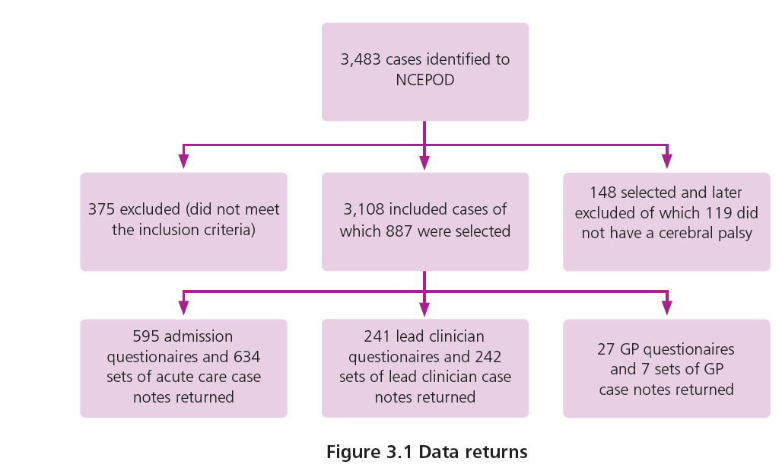
Data returns

Slide 11
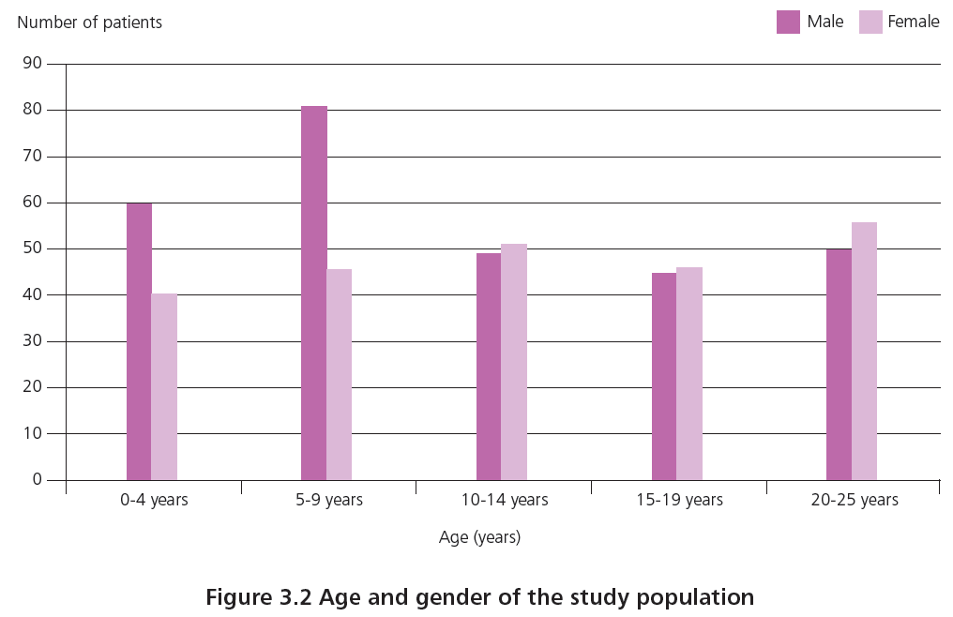
Age and gender

Slide 12
Recommendations
35 recommendations made
  Improving clinical coding and the quality of routine data
  Diagnosis and management
  Clinical leads and care planning
  Transition and age appropriate care
  Communication
  The organisation of care

Slide 13
Alison Kemp
ROUTINE NATIONAL DATA

Slide 14
Method -routine national datasets
Scoping available data
Governance issues
Application for data from four countries
Data preparation at source
Data linkage
Data cleaning and preparation
(complete for all countries by Oct 2017)

Slide 15
Population
The study population included children and young people
Aged 0-25 years who had a cerebral palsy
  stratified in five year age bands (0-4, 5-9, 10-14, 15-19, 20-24 completed years)
Resident in England, Wales, Scotland, Northern Ireland
Time period (2004-2014)
Compared to children without a cerebral palsy

Slide 16
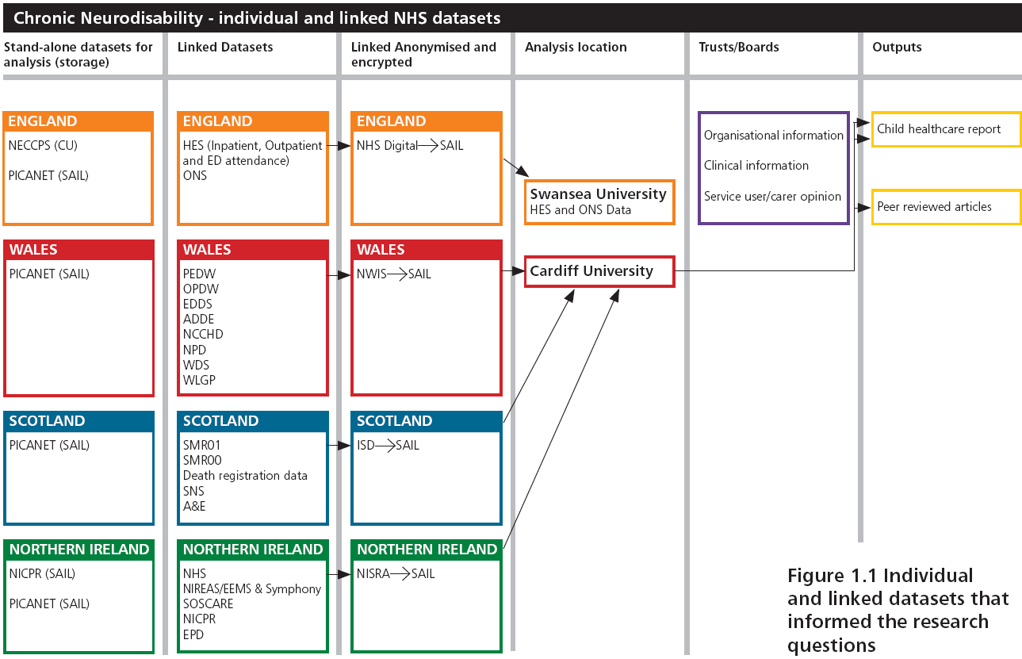
Datasets

Slide 17
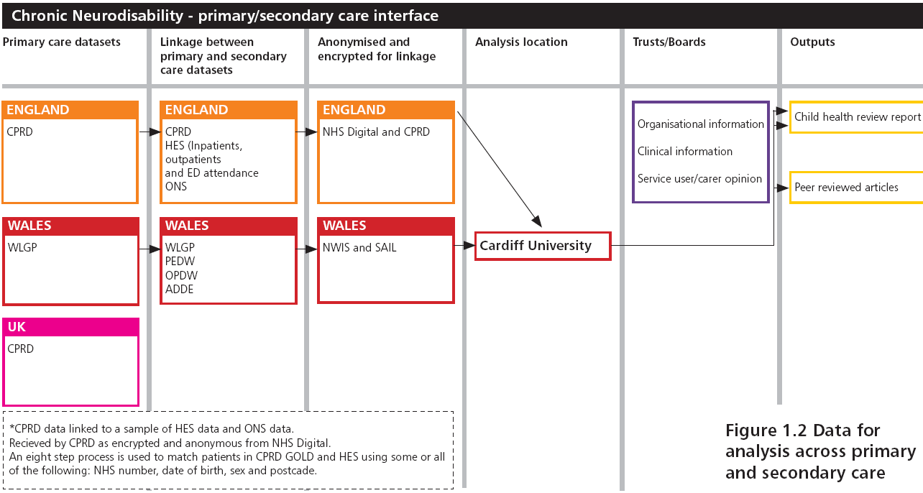
Primary/secondary care interface

Slide 18
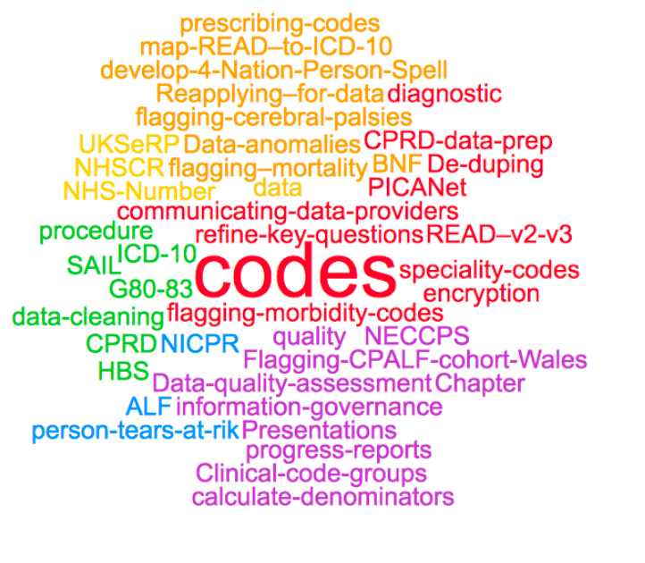
Data preparation

Slide 19
Recommendation 1
Clinical coding of neurodisabling conditions in all healthcare records and routinely collected datasets must be accurate and consistent if data are to be meaningful, comparable and useful to inform health outcome reviews and patient care.
a) Cerebral palsy and other chronic neurodisabling conditions should be added to the standard list that “must always be coded for any admitted patient care episode (including day case patients) when documented in the patient’s medical record for the current hospital provider spell, regardless of specialty.”
b) Standardised healthcare data should be captured by clinicians each time a patient is seen, in ALL settings (to include community based organisations)

Slide 20
Recommendation 1 (continued)
c) Data collection about patients with neurodisabling conditions must include measures of clinical severity and functional abilities to enable detailed analysis
d) Clinical coding systems should be harmonised across routinely collected datasets in England, Wales, Scotland and Northern Ireland to enable data analysis throughout the UK
e) Patient records and routine data collections across different healthcare providers (community care, primary care, secondary care and mental health) should be linked to provide the greatest potential for quantifying healthcare utilisation and patient outcomes on a population basis.

Slide 21
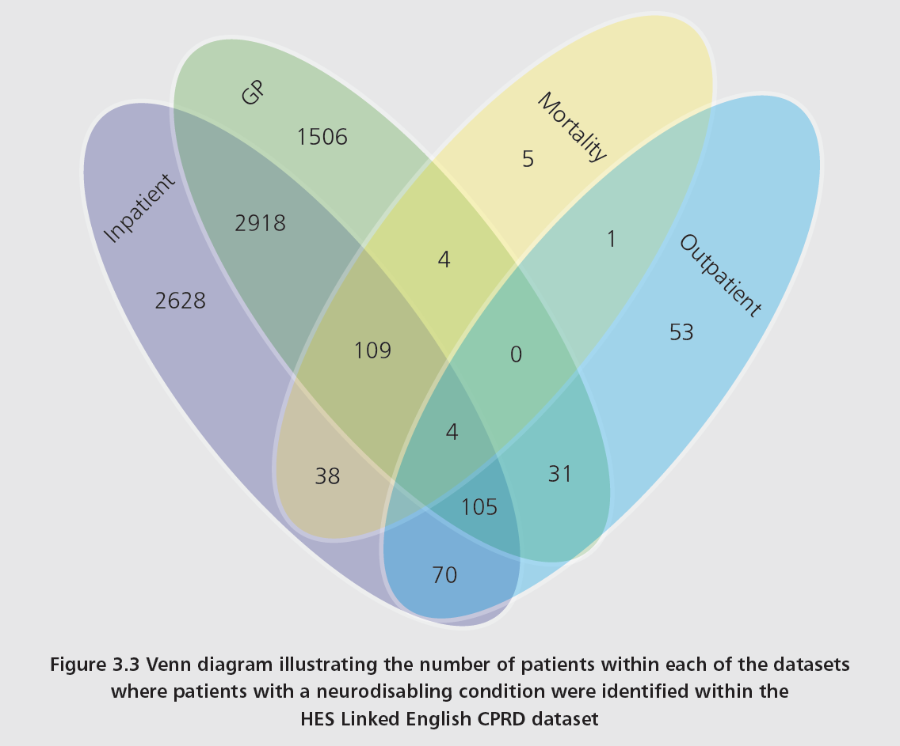
Case ascertainment

Slide 22
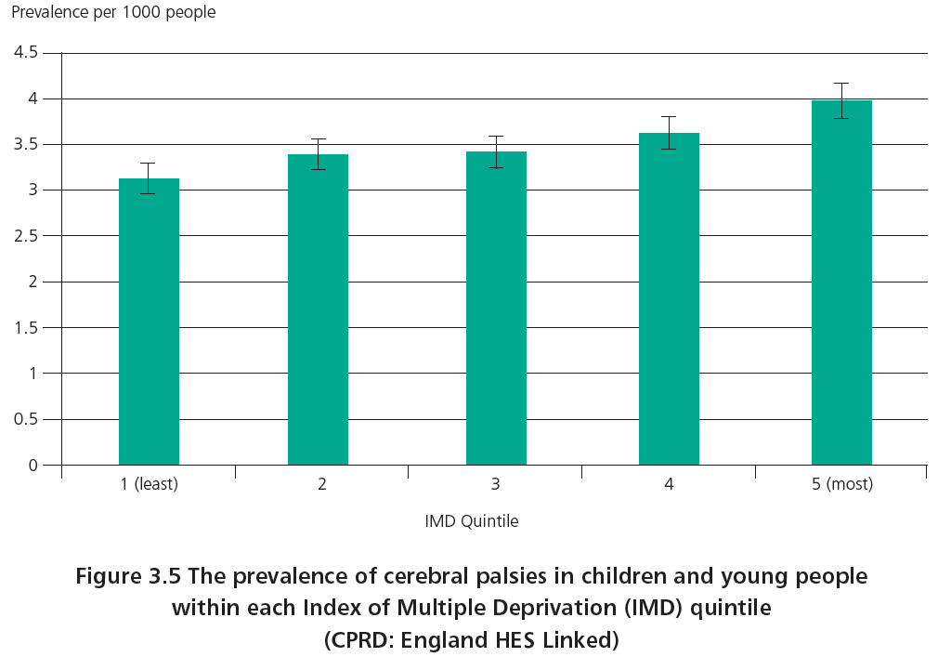
Prevalence of cerebral palsy by index of multiple deprivation (overall 3.5/100,000 England)

Slide 23
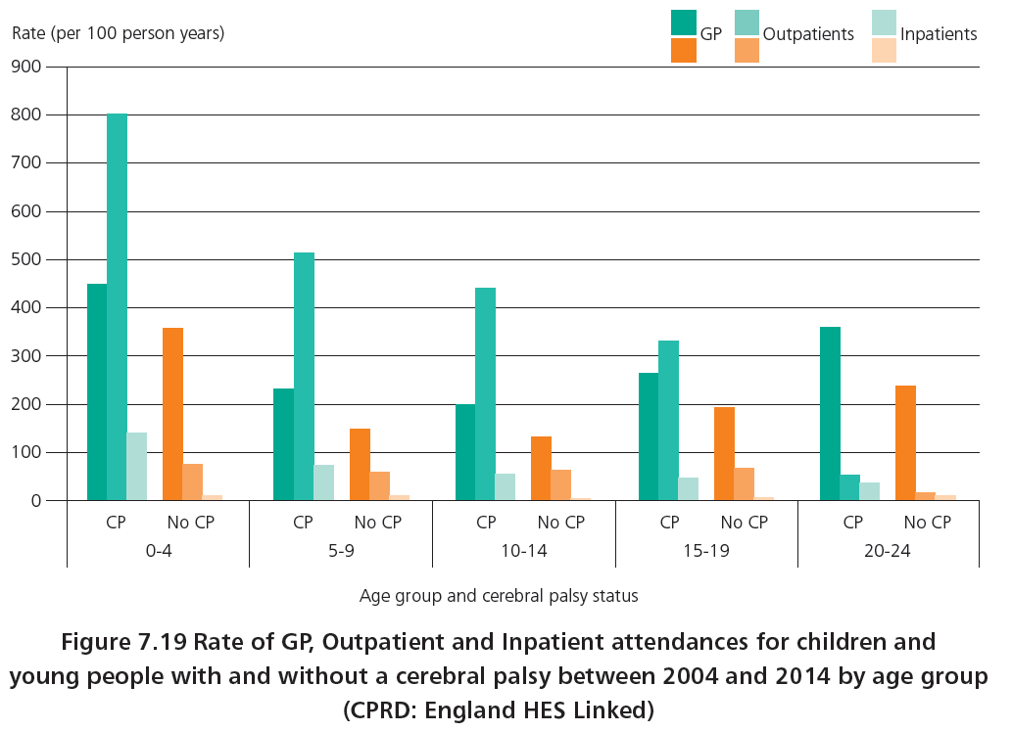
Primary and secondary health care attendances

Slide 24
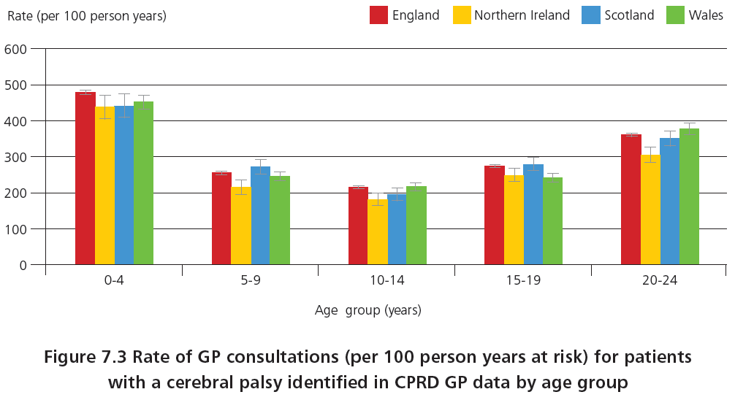
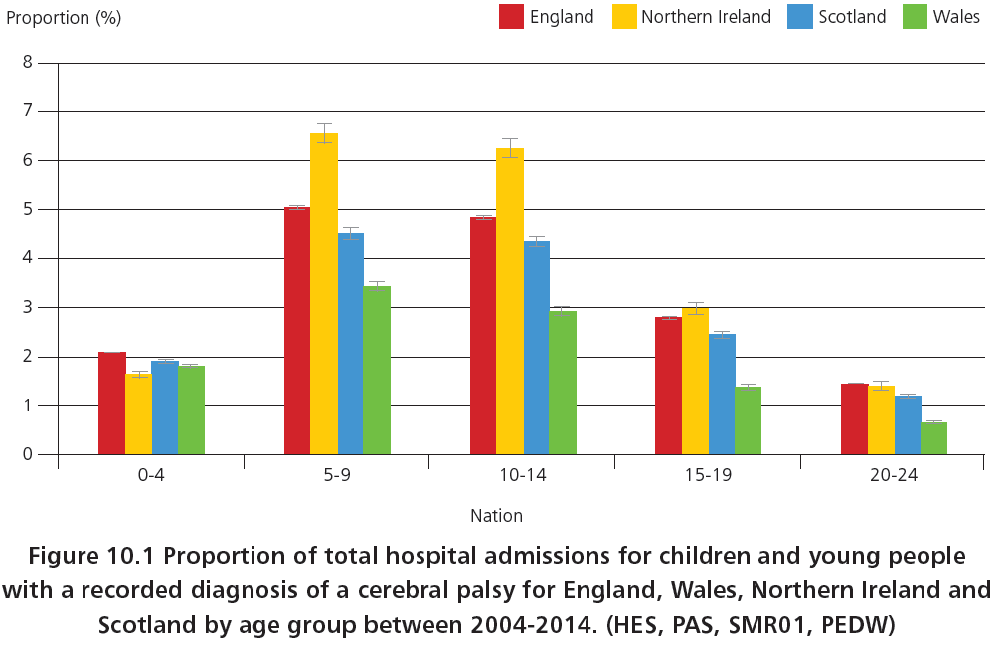
Data consistency across countries

Slide 25
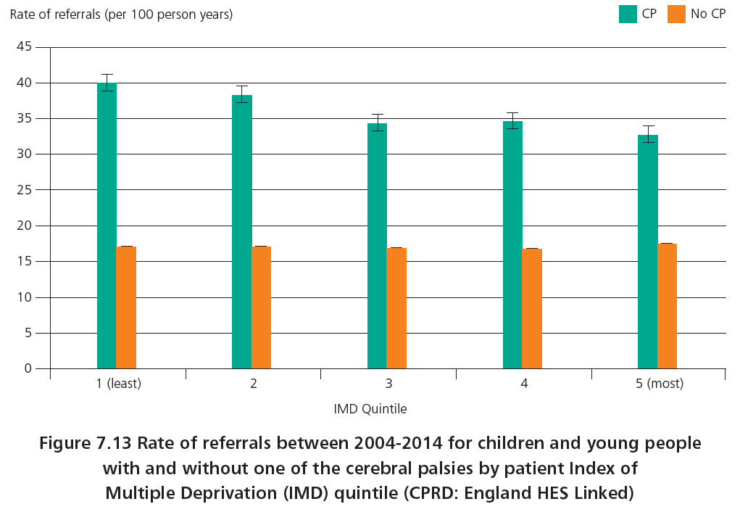
Referrals with respect to index of multiple deprivation

Slide 26
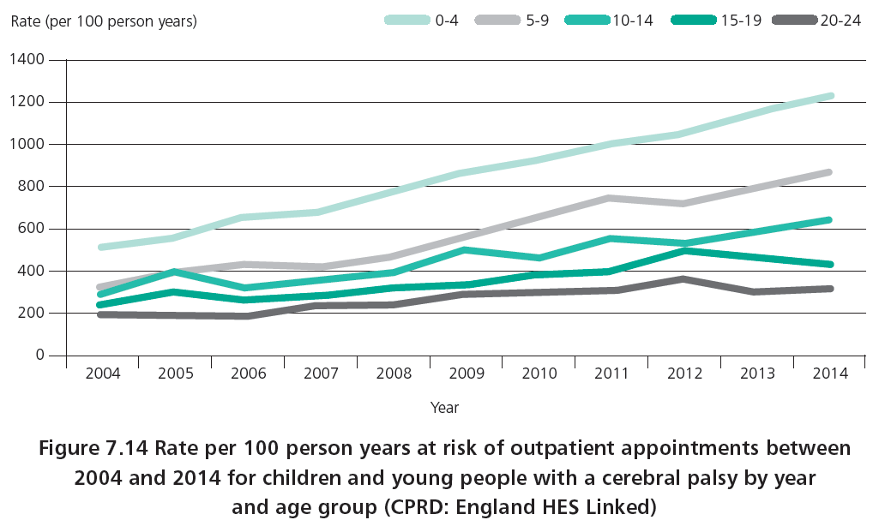
Outpatient appointments have increased

Slide 27
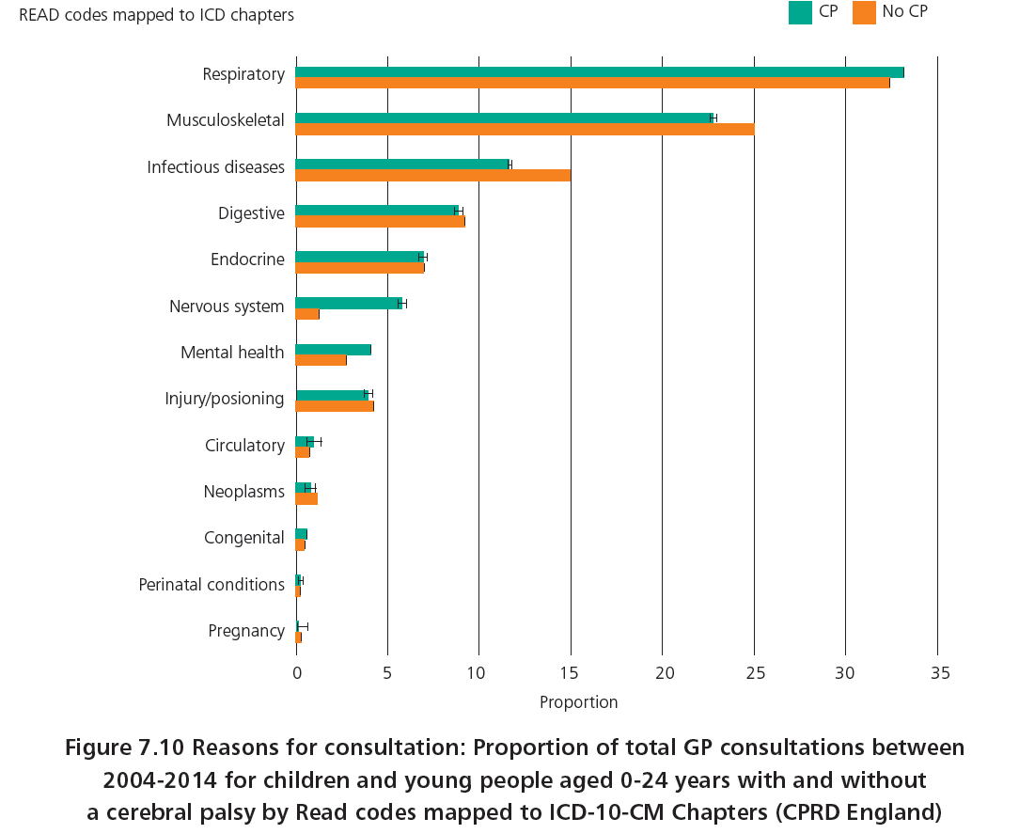
GP attendances

Slide 28
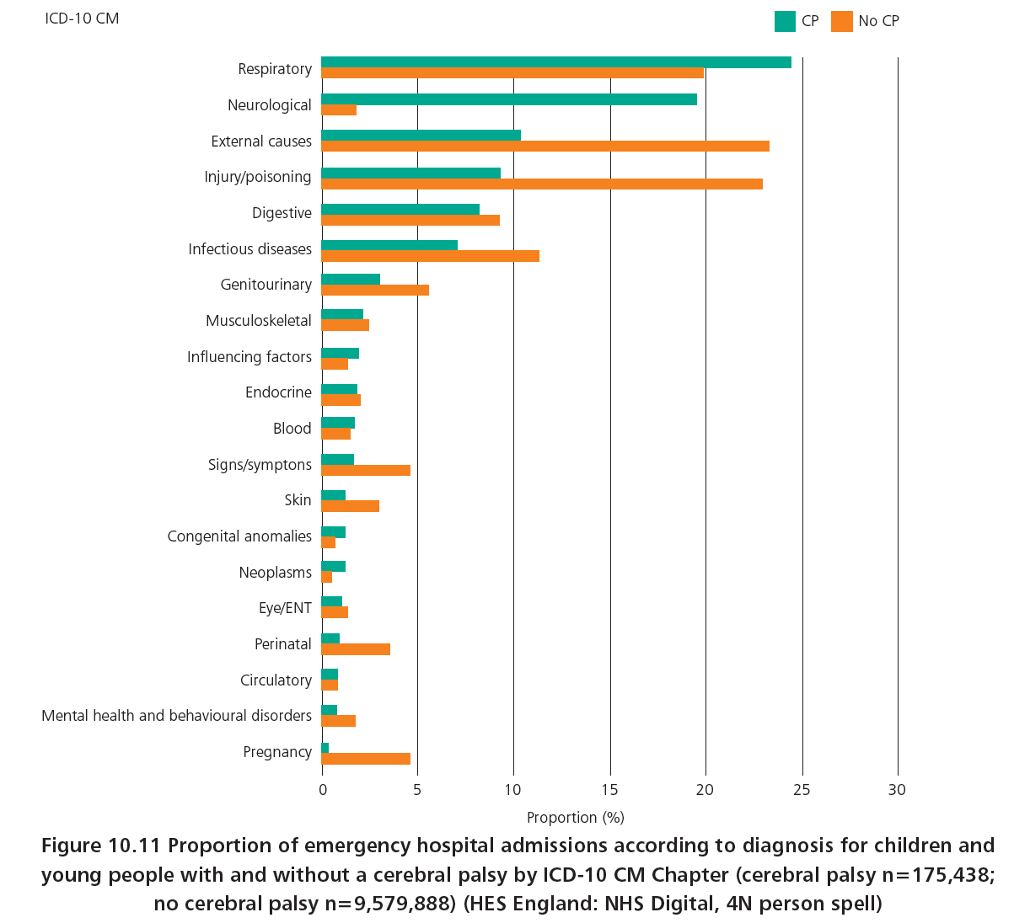
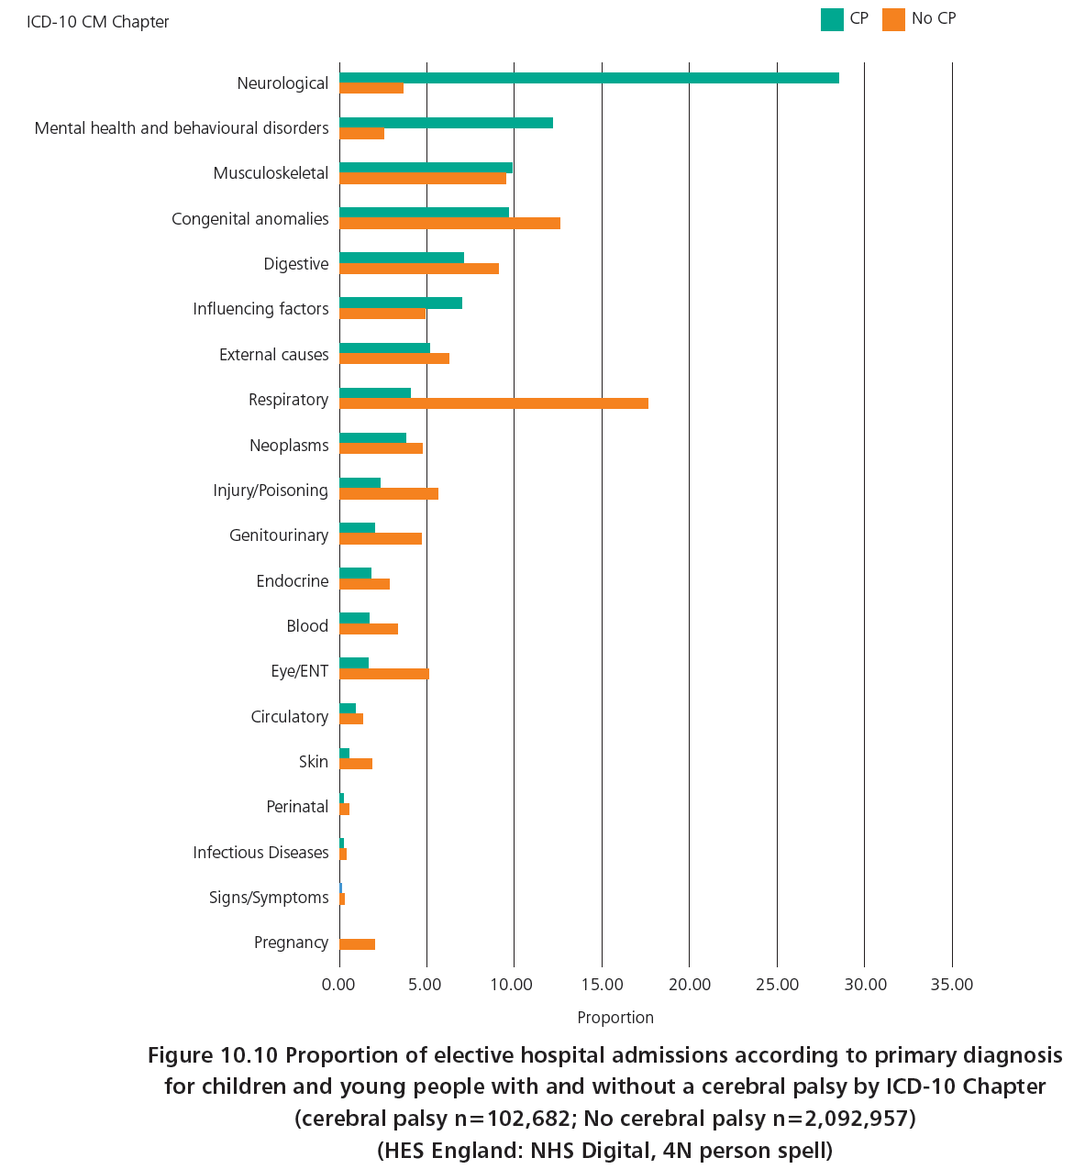
Hospital admissions
Emergency
Elective

Slide 29
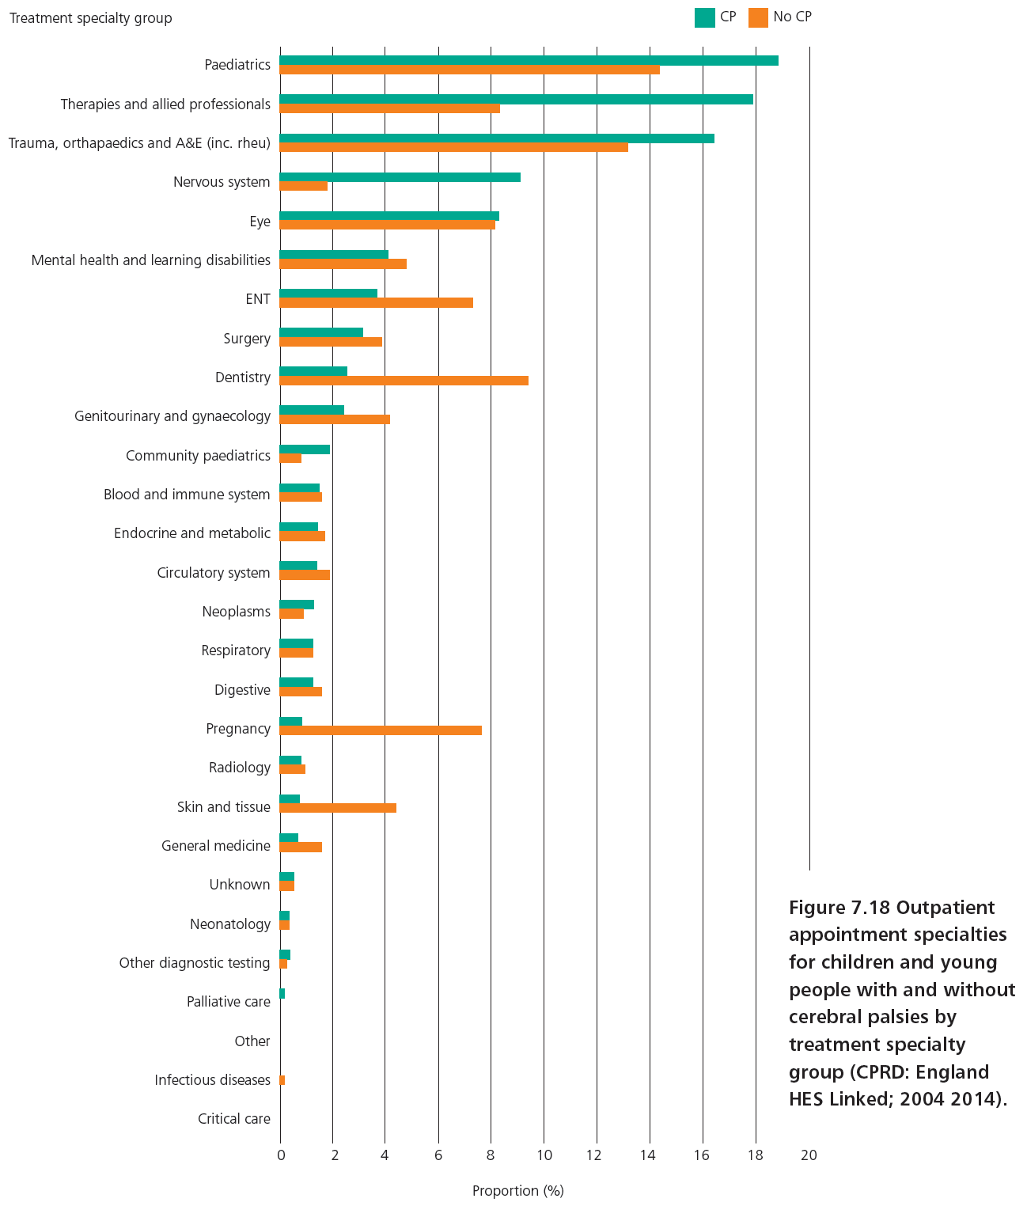
Outpatients

Slide 30
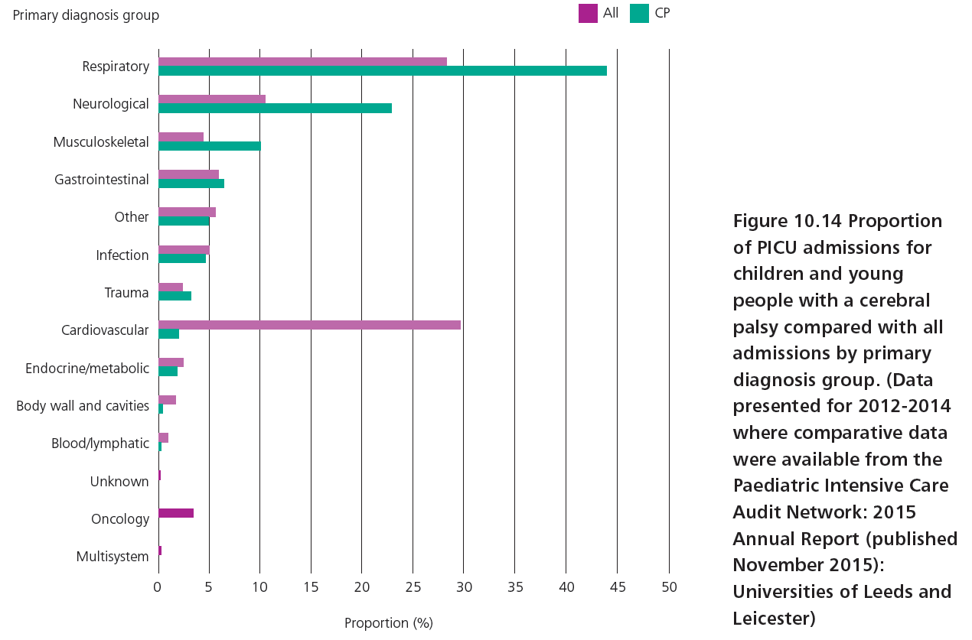
Paediatric intensive care

Slide 31
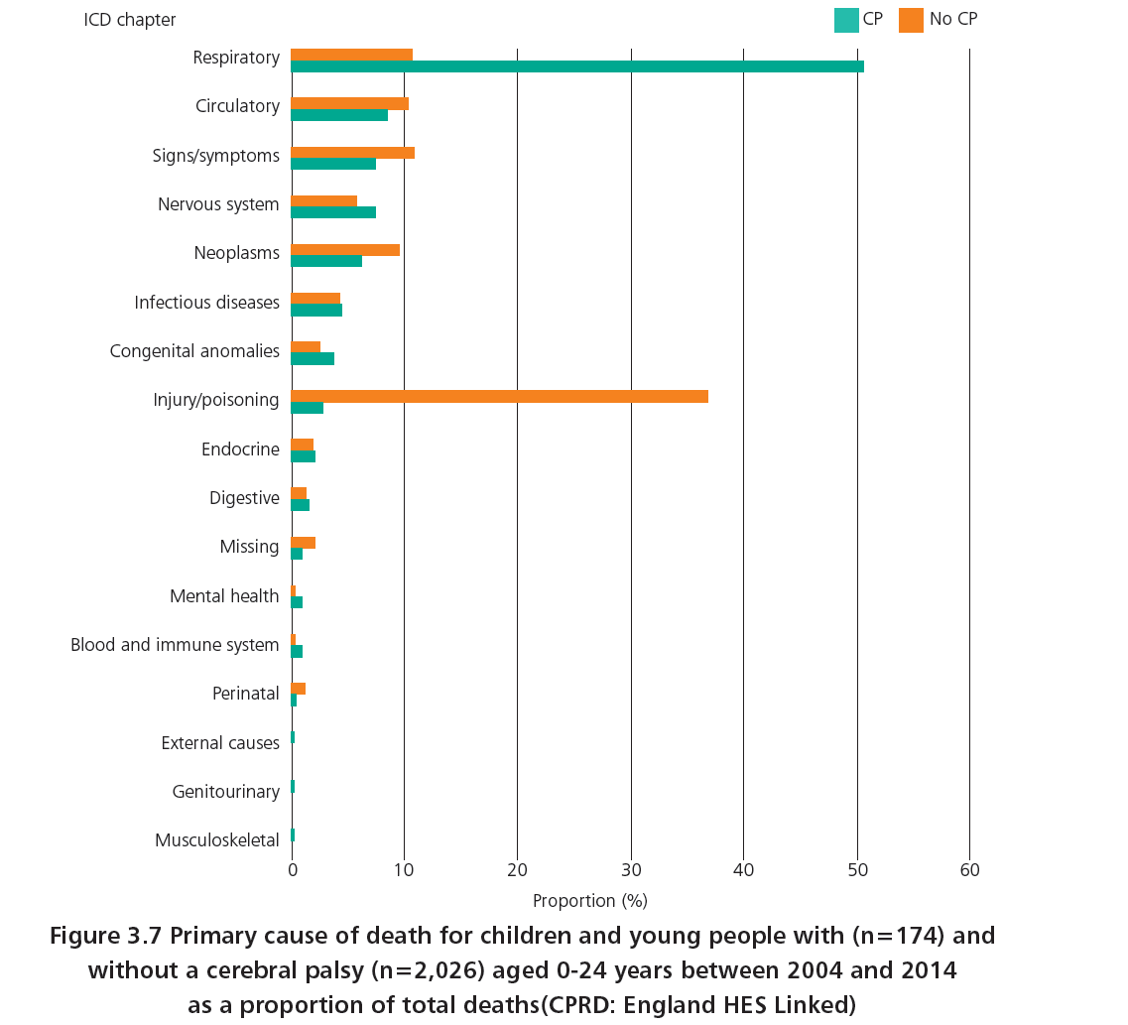
Mortality - cerebral palsy 5.3/1000
No cerebral palsy 0.2/1000

Slide 32
Recommendation 13
Patients with a neurodisabling condition should have an assessment completed by their lead clinician to determine their risk of respiratory compromise. This should be reviewed as appropriate for the complexity of the patient’s needs. Those patients at significant risk of respiratory compromise should be assessed by clinicians with expertise in respiratory medicine, in order to discuss with the patient and their family the range of interventions most likely to lead to the best outcome. ‘What to do’ and ‘who to contact’ in the event of respiratory symptoms should be documented in the patient-held Emergency Health Care Plan.

Slide 33
Recommendation 10
Oral health and dental care for patients with a neurodisabling condition must be considered as a matter of routine by their lead clinician.

Slide 34
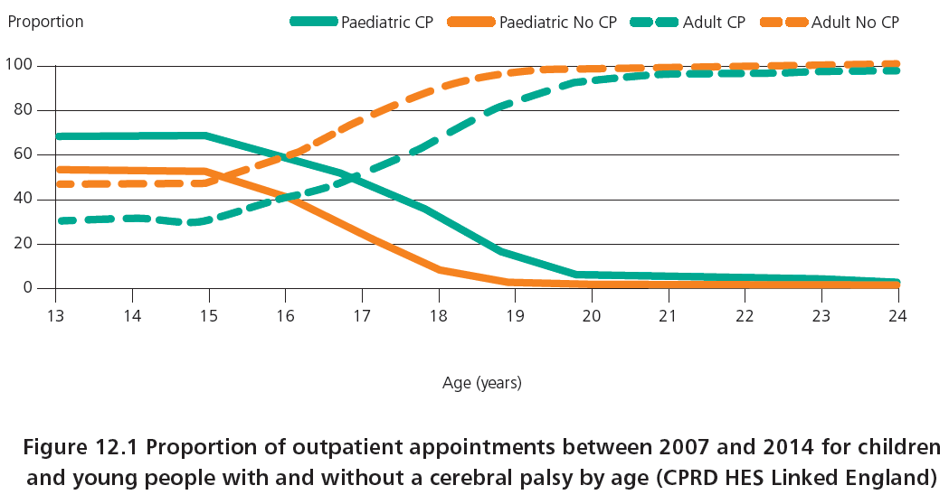
Transition - outpatients

Slide 35
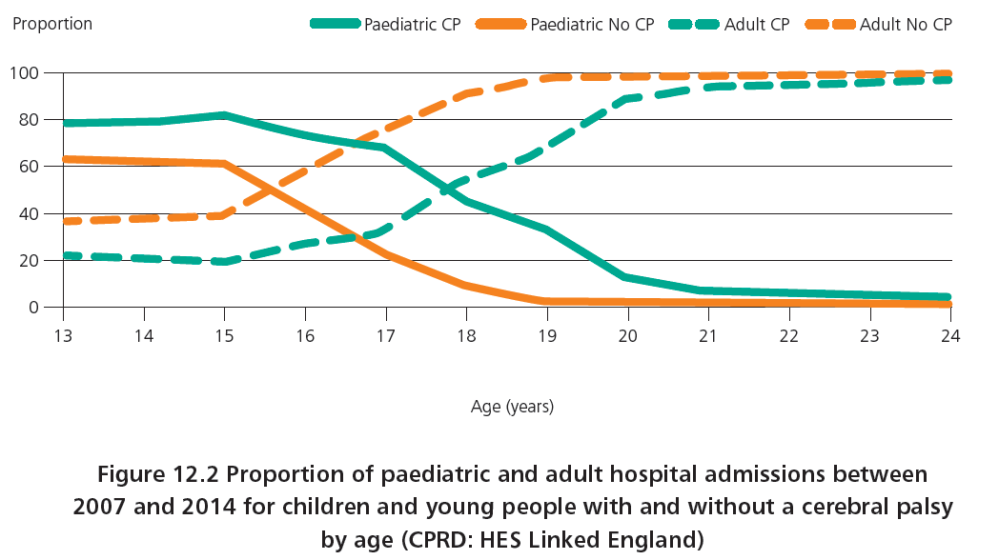
Transition - hospital admissions

Slide 36
Kathy Wilkinson
ACUTE INPATIENT CARE & TRANSITION

Slide 37
Principal recommendation 11
All patients with complex needs and, where appropriate, their parent carers or legal guardians, should be offered the opportunity to develop a patient-held Emergency Health Care Plan/Emergency Care Summary to facilitate communication in the event of a healthcare emergency.
The existence of this Emergency Health Care Plan/ Emergency Care Summary must be recorded in all communication and case notes and this should be subjected to local audit.

Slide 38
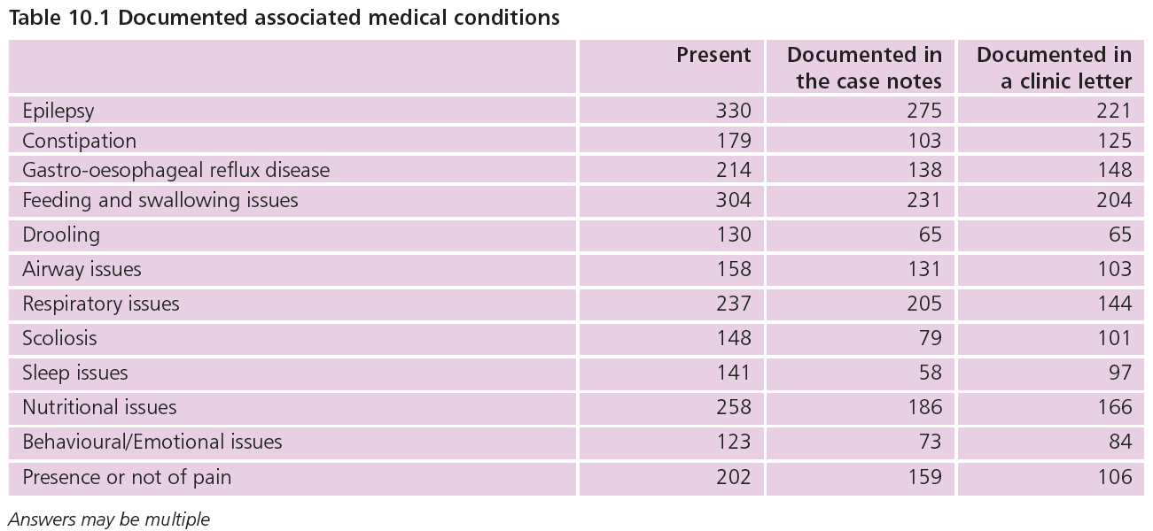
Acute admission - comorbidity

Slide 39
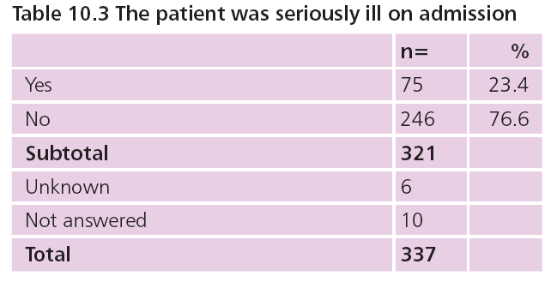
Seriously ill - emergency admission

Slide 40
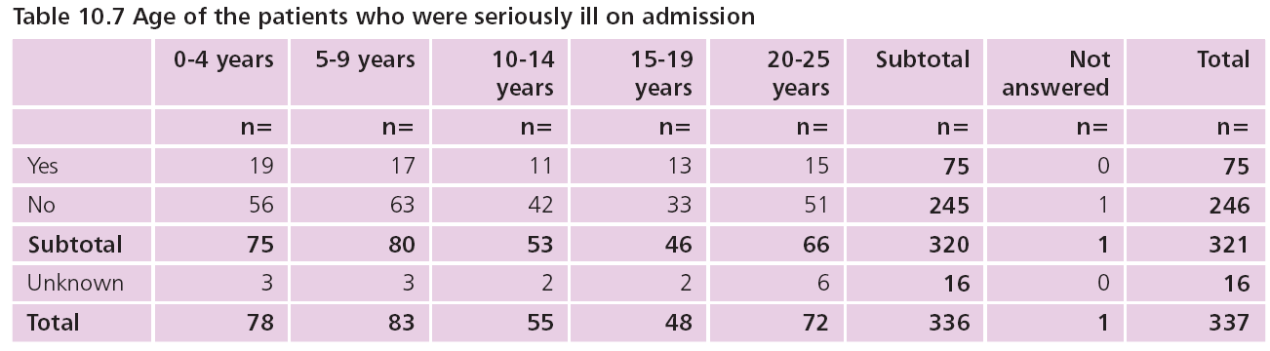
Seriously ill on admission

Slide 41
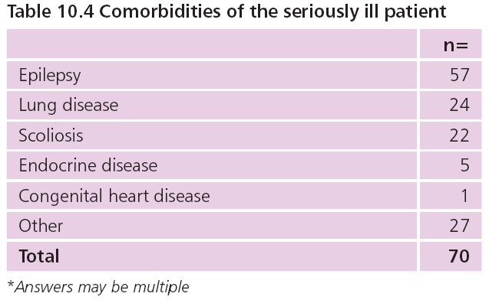
Comorbidities of the seriously ill patient

Slide 42
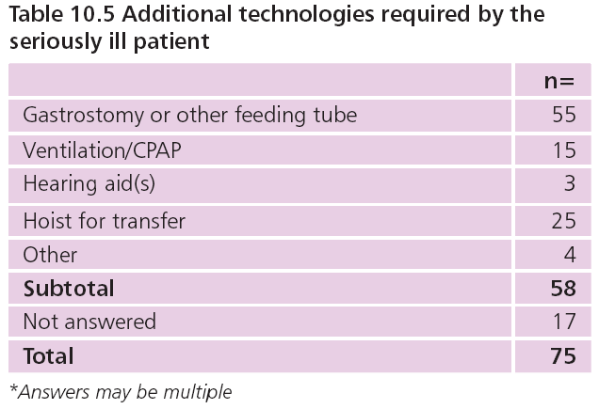
Additional needs

Slide 43
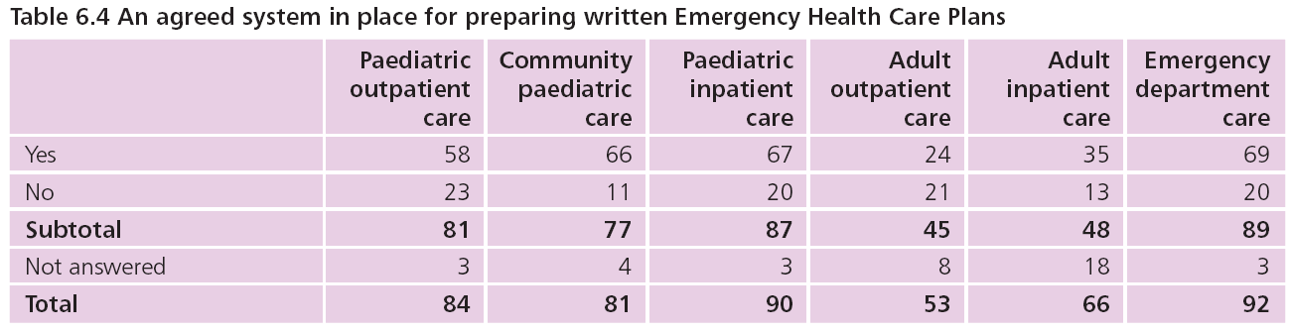
Emergency health planning - organisational preparation

Slide 44
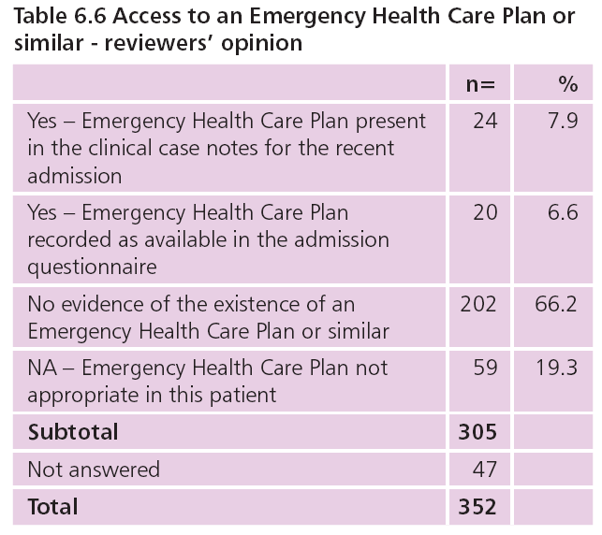
Was an emergency health plan available?

Slide 45
Case study 16 - emergency planning
A young adult with a long term tracheostomy was admitted for seizures under the care of a respiratory clinician with support from a neurologist in a different centre. The patient had had a similar admission three weeks earlier with no clear ongoing management plan. During this admission they were seen daily by the critical care outreach team with excellent documentation of the tracheostomy care and respiratory status. However, there was no overall leadership of the patients neurodisability needs.
Reviewers noted:
Had clear leadership been in place in the community admission might have been avoided.

Slide 46
Recommendation 19
All medically frail patients with a neurodisabling condition, and where appropriate, their parent carers or legal guardians, must be offered the opportunity to discuss with their lead clinician, their care wishes in the event of serious illness or sudden collapse. This should be recorded in their patient-held Emergency Health Care Plan. This may include discussing Do Not Attempt Cardio Pulmonary Resuscitation decisions and palliative care plans, which should be validated at each point of care according to the existing legal requirements and professional guidance. This is particularly important to have in place at handover during transition to adult services.

Slide 47
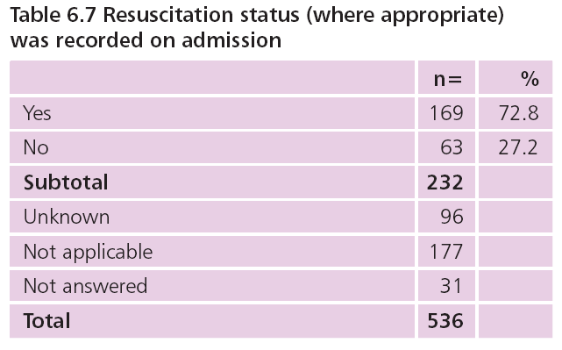
Was resuscitation status recorded where appropriate?

Slide 48
Case study 6 - resuscitation
Older teenager with bilateral spastic cerebral palsy at GMFCS level V. Profound learning disability, epilepsy, gastrostomy tube fed, scoliosis, and recurrent chest infections was admitted from the local hospice for an uneventful routine change of gastrostomy button without anaesthetic. The patient was discharged the same day back to the hospice, where they died peacefully four days later.
Reviewers noted:
Strong leadership of multidisciplinary care and a clear Emergency Health Care Plan in place, agreed with all family and healthcare providers
Possible clinical scenarios were included in the plan, with step by step action plans.
A completed Recommended Summary Plan for Emergency Care and Treatment (ReSPECT) was also available.
The care plan had been carefully followed and there was evidence of excellent clinical care and support for the family.

Slide 49
TRANSITION

Slide 50
Principal recommendation 22
The transition plan between children’s to adults’ services should be co-ordinated by the lead clinicians and integrated within other multiagency plans e.g. Health education, social care planning and mental healthcare services. The patient’s team in primary care must be part of the planning process.

Slide 51
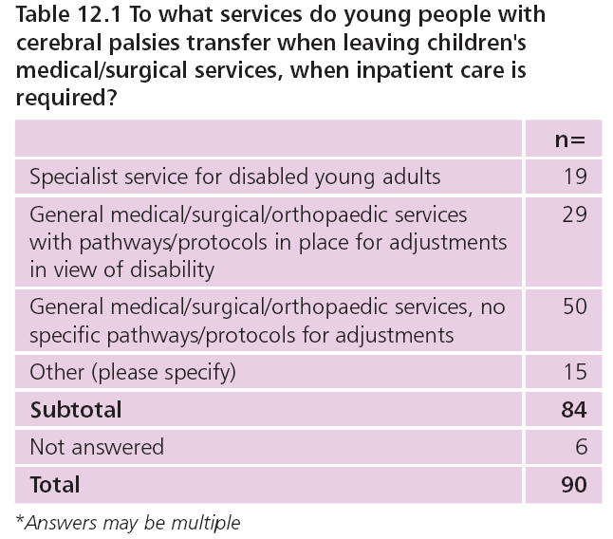
Inpatient care after childhood

Slide 52
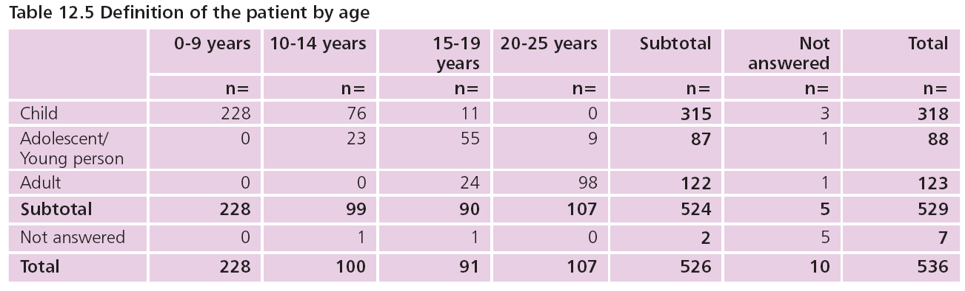
Defining patients by age

Slide 53
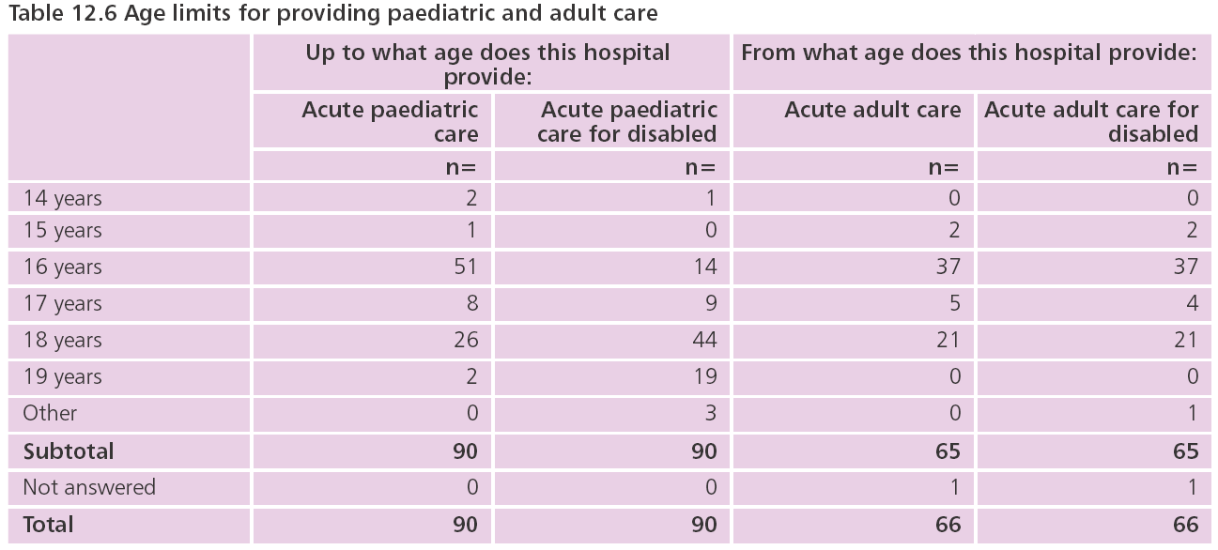
Age limits for paediatric and adult care

Slide 54
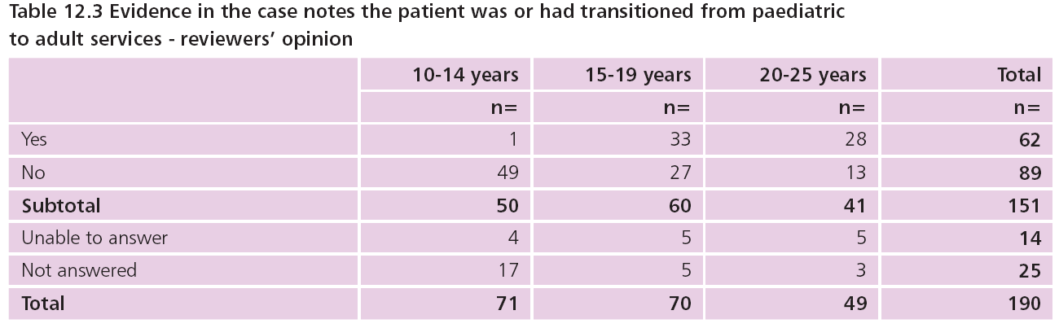
Evidence of transition to adult services

Slide 55
Case study 29 - lost in transition?
A young adult patient GMFCS level III cerebral palsy under a paediatrician was using a wheelchair at school.
They were going to university 50 miles away and needed to continue their healthcare support there.
The last letter from the consultant paediatrician stated that it had proved impossible to identify an adult neurodisability lead to supervise the patient’s care.
Reviewers noted:
Adult neurodisability leads’ involvement in patients with a cerebral palsy may be limited to spasticity management.
Generally after transition it was up to the patient’s GP, and on occasion interested surgeons, to offer care leadership.
Patients and families often felt abandoned as a consequence & clinicians gave examples that physical and mental health of their patients deteriorated as a consequence.

Slide 56
Recommendation 30
Patients with a neurodisabling condition should be involved in all communications and decision-making about their care and management where possible, and where appropriate, with adjustments in place to support their involvement, including specialist speech and language therapists as required. Parent carers or legal guardians must also be included in these conversations as appropriate.

Slide 57
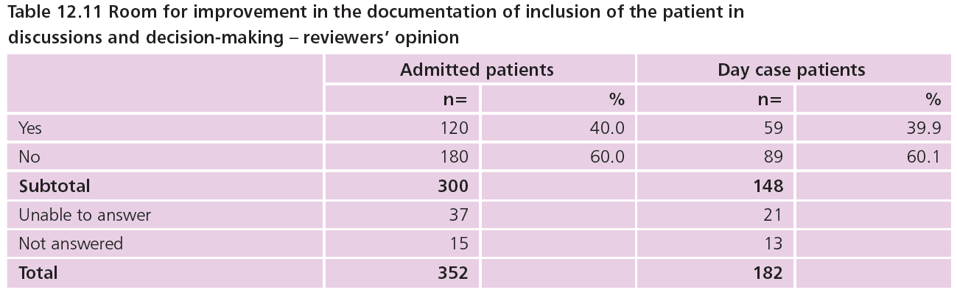
Evidence of patient inclusion

Slide 58
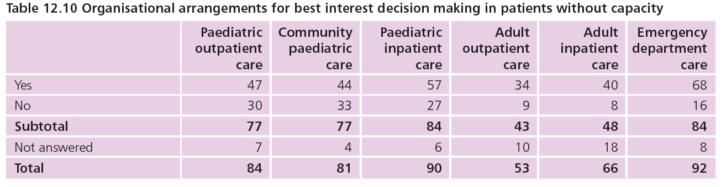
Best interest decision-making when patient lacked capacity

Slide 59
Case study 24 - consent
A young adult with GMFCS level II cerebral palsy and learning disabilities was admitted for routine surgery.
Records indicated that the patient was needle phobic and required considerable persuasion to have a premedication before attending the operating theatre.
The patient’s parent carer appeared to be the sole signatory on the consent form.
There was no record in the notes of the patient’s mental capacity and their own views on having this surgery.
Reviewers noted:
This practice was unsatisfactory and that in the absence of best interest decision making having been documented and agreed this consent was against GMC and legal guidance.

Slide 60
Karen Horridge
EACH AND EVERY NEED

Slide 61
Principal recommendation 3
Patients suspected of having a neurodisabling condition should have an expert assessment by clinicians who have the competences to consider the range of possible diagnoses. For those patients with a cerebral palsy, the clinician must be able to recognise and describe the tone variation and distribution pattern of motor impairment, as informed by ‘NICE Guideline 62’ and the ‘Reference and Training Manual of the Surveillance of Cerebral Palsy in Europe’.

Slide 62
Cerebral palsy - a precise diagnosis
Documentation of the patient’s specific cerebral palsy diagnosis was recorded by the case reviewers in 430/540 (79.6%) cases
No such documentation in 110/540 cases (20.4%)
150/521(28.8%) cases reviewed the term used to describe the diagnosis was ‘cerebral palsy’, with no more specific detail of tone variation
In a further 76/521(14.6%) only the term ‘bilateral cerebral palsy’ was used, but the tone variation was not described
The diagnostic term did not include information about the specific tone variation in 297/521(57%) cases

Slide 63
Case study 1 - diagnosis
Teenage patient reviewed in paediatric clinic.
Documented diagnosis in case notes: ‘ataxic cerebral palsy’.
Clinical assessment documented changing profile of needs over time that did not fit with this. Further investigations were arranged.
Reviewers noted:
  Evidence of investigation findings was diagnosis NOT cerebral palsy, but one of a rare group of conditions with progressive and multi-system effects that required a completely different, proactive healthcare management plan than that for a person with ataxic cerebral palsy.
  It is always good practice to review the evidence for, or against, any diagnostic labels and be prepared to reinvestigate in the light of new information or new diagnostic technologies.

Slide 64
Principal recommendation 7
Patients with a neurodisabling condition should have access to an appropriate multidisciplinary team to proactively monitor their health status when their needs are complex and/or when there is a change in their functional status, physical condition or environmental situation.
For those patients with a cerebral palsy, this access should reflect ‘NICE Guideline 62’.

Slide 65
Multidisciplinary care
Essential for those with complex needs
Considerable variation in clarity about who led MDT care, especially for young adults
Viewed as inadequate for 137/285 (48.1%) cases reviewed
Discharge summaries about inpatient care not copied to:
  lead for disability care in ~ half of cases
  community physiotherapist for 30% day cases and 38% admitted patients
Evidence of adequate post-op physiotherapy input found in < 6/10 cases

Slide 66
Case study 8 - multidisciplinary care
Young child with bilateral spastic cerebral palsy admitted as day case for Botulinum Toxin injections. Completed with no documented complications.
Reviewers noted:
  Clear documentation in acute admission notes that intensive physiotherapy was required in the community following the intervention
  BUT no documentation of any communication from acute care team to the community physiotherapist about this.
Good practice would have been:
  Advanced communication between acute care team and community physiotherapist, giving notice of date of intervention.
  As a minimum, there should be communication on discharge directly with the community physiotherapist, rather than leaving the communication for the patient/parent to arrange.

Slide 67
Principal recommendation 18
Patients with a neurodisabling condition should have a clear care plan that describes and addresses all of their needs. For those with a cerebral palsy this should specifically include:
Pain, growth, nutritional status, safety of eating and drinking, and other medical conditions such as seizures or mental health or behavioural issues.
This care plan should be reviewed and updated when in hospital and on discharge to the community. Where the patient has complex needs this should be readily accessible to patients, their parent carers and clinicians e.g. as part of a patient-held patient passport.

Slide 68
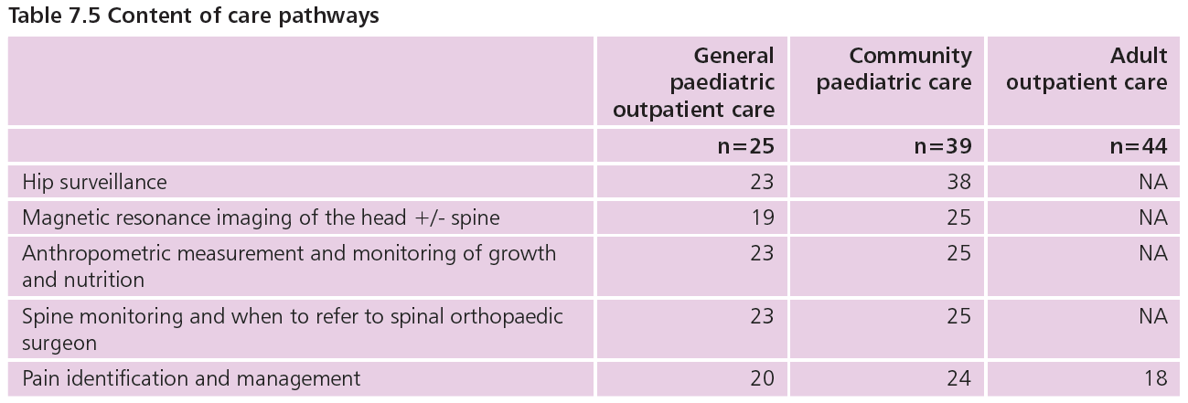
Care pathways
An agreed, written care pathway for assessment, diagnosis and management of children and young people with cerebral palsies was reported as not in place by:
56/82 leads for paediatric outpatient care
42/81 leads for community paediatric care
42/48 leads for adult outpatient care

Slide 69
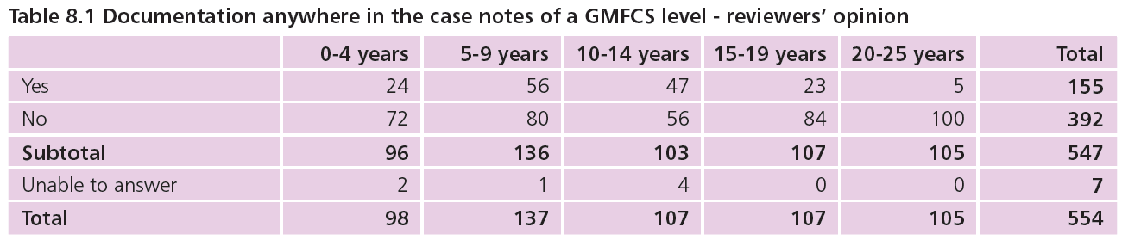
Gross Motor Function Classification System (GMFCS)
Reviewers found documentation in case notes of the patient’s Gross Motor Function Classification System (GMFCS) level in only 155/547 (28.3%) cases reviewed

Slide 70
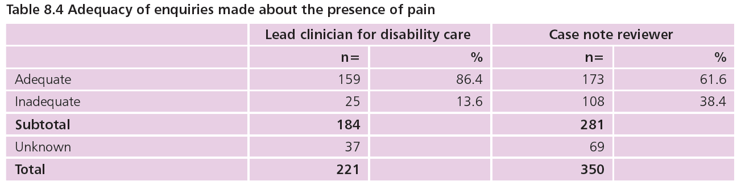
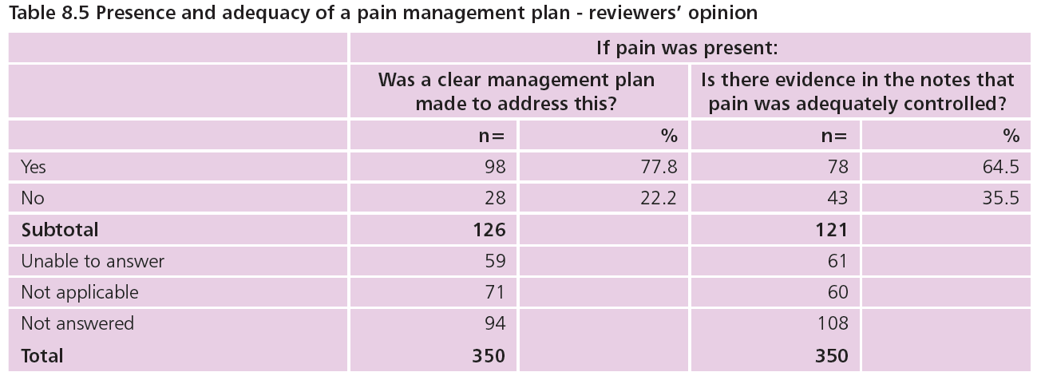
Pain management

Slide 71
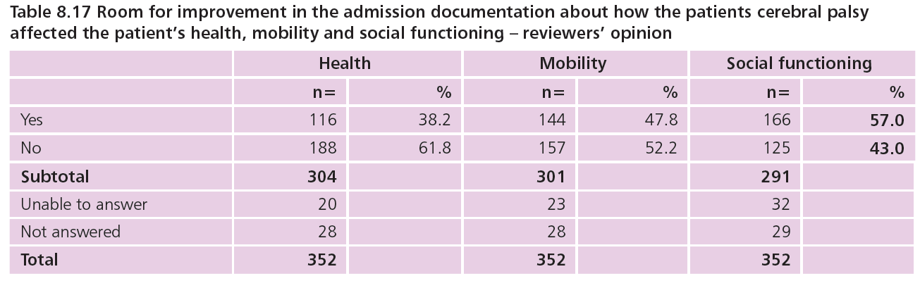
Effect of the cerebral palsy on the patient’s health

Slide 72
Each and Every Need
Level of learning ability reported as assessed and documented on admission in 188/433 (43.4%) – admission questionnaire data
Preferred communication method of patient documented in 187/530 (35.3%) case notes and 163/428 (38.1%) clinic letters – reviewer data
Patient’s weight not documented in case notes for 79/254 (31.1%) admitted and 73/177 (41.2%) day case patients – reviewer data
Clinical concern about weight, growth or nutritional condition reported for 62/213 (29.1%) patients – lead clinicians for disability care data
198/333 (59.5%) patients nutritionally vulnerable, but adequate, regular assessment of nutritional status in 160/185 (86.5%), but not for 25/185 (13.5%) – reviewer data

Slide 73
Case study 9 - weight measurement
Young child with bilateral spastic cerebral palsy and multiple associated health conditions admitted with chest infection. Antibiotics prescribed and given, patient observed overnight then discharged home.
Teenager with bilateral cerebral palsy at GMFCS level IV admitted as day case for Botulinum Toxin injections. Procedure completed and patient discharged home.
Reviewers noted:
  No weight documented in case notes of either patient.
  Complex, vulnerable patients, at high risk of nutritional compromise.
  Accurate dose calculation for drugs depends on accurate weight.
  Absence of appropriate equipment wheelchair scales, hoists etc. often cited as reason for not weighing patient.

Slide 74
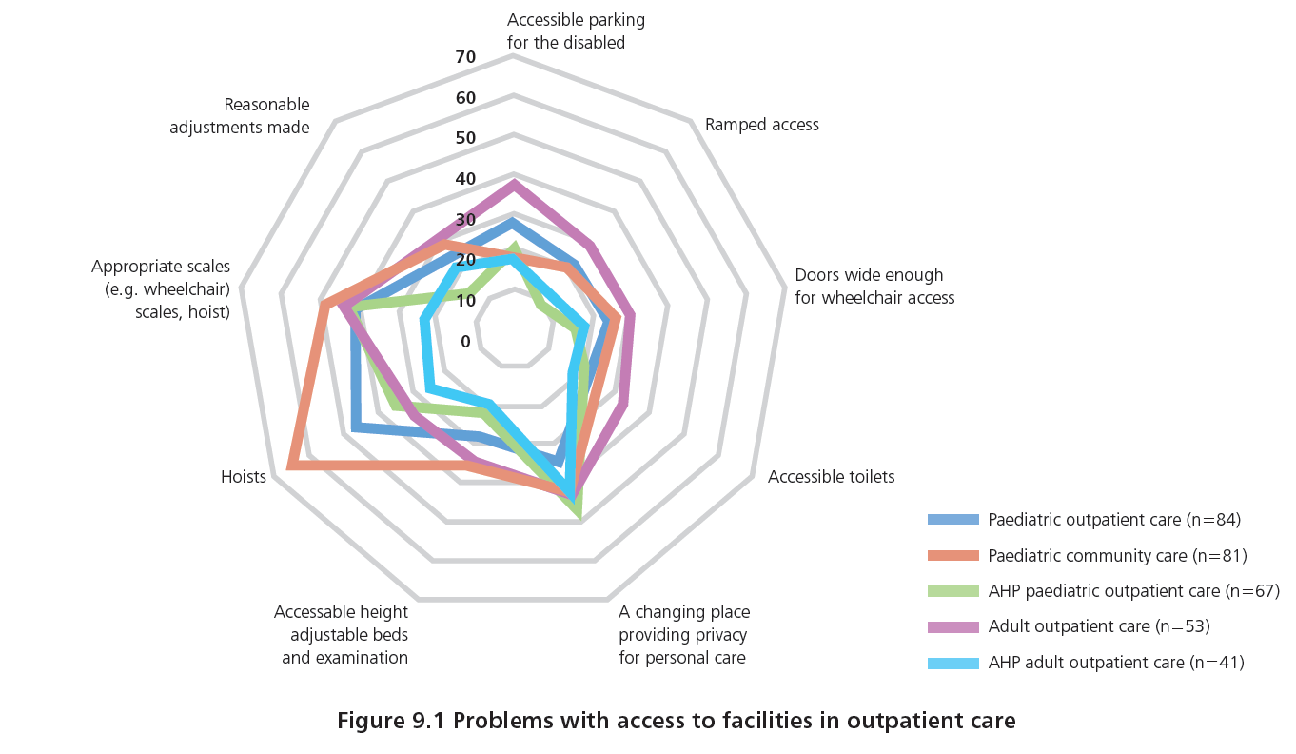
Access to facilities - outpatients

Slide 75
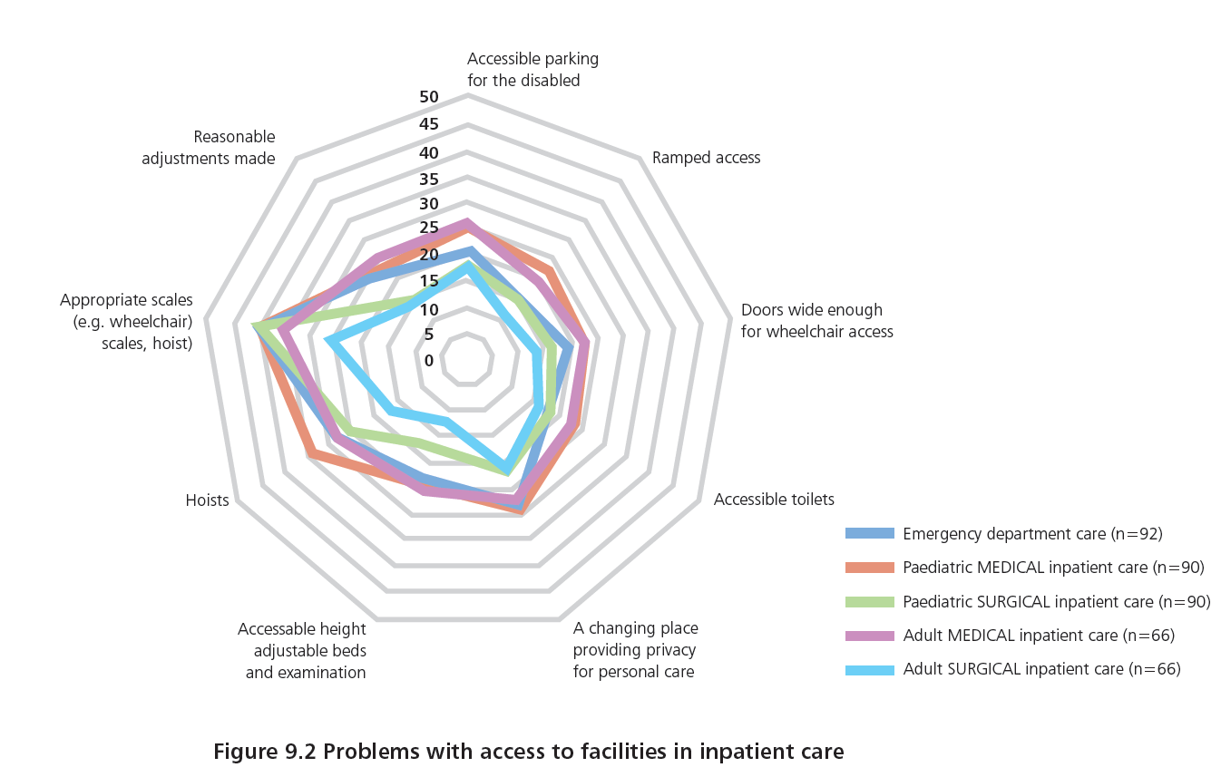
Access to facilities - inpatients

Slide 76
Summary
There is variation in the identification and management of each and every need of children and young people with cerebral palsies across settings, over time and with age
We commend this Child Health Outcome Review to all who provide health care for disabled children and young people
If all recommendations are implemented, unwanted variation in care – and thus in outcomes – should be addressed

Slide 77
SPRING
I am March, April, May,
I am new life starting today.
I am brisk and bright,
I am a flying fluttering kite.
I am trees in the breeze,
I am cold, go away please.
I am the sun in the sky,
I am wispy clouds high.
(c) Adam Bojelian 2012

